Slide 2
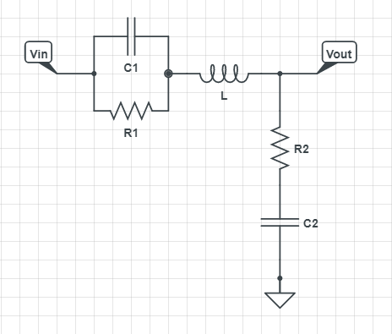
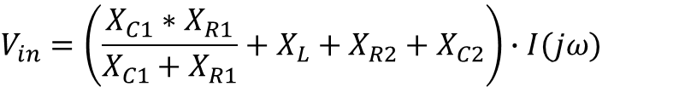


Circuito Seletor de Frequências
$$V_{in}=\left(\frac{X_{C1}∗X_{R1}}{X_{C1}+X_{R1}}+X_{L}+X_{R2}+X_{C2}\right)∙I(jω)$$
$$V_{out}=\left(X_{R2}+X_{C2}\right)∙I(jω)$$
$$I(jω)$$
$$H\left(jω\right)=\frac{V_{out}}{V_{in}}$$

